Slide 1
Building a User Music Taste Profiles with Spotify Data
Capstone Project
Jeremy Osir
NYCDSA
Winter 2022 Cohort
Notes:
My name is Jeremy Osir, and today I will be presenting my machine learning capstone project where I build a user’s music taste profile using Spotify data.

Slide 2
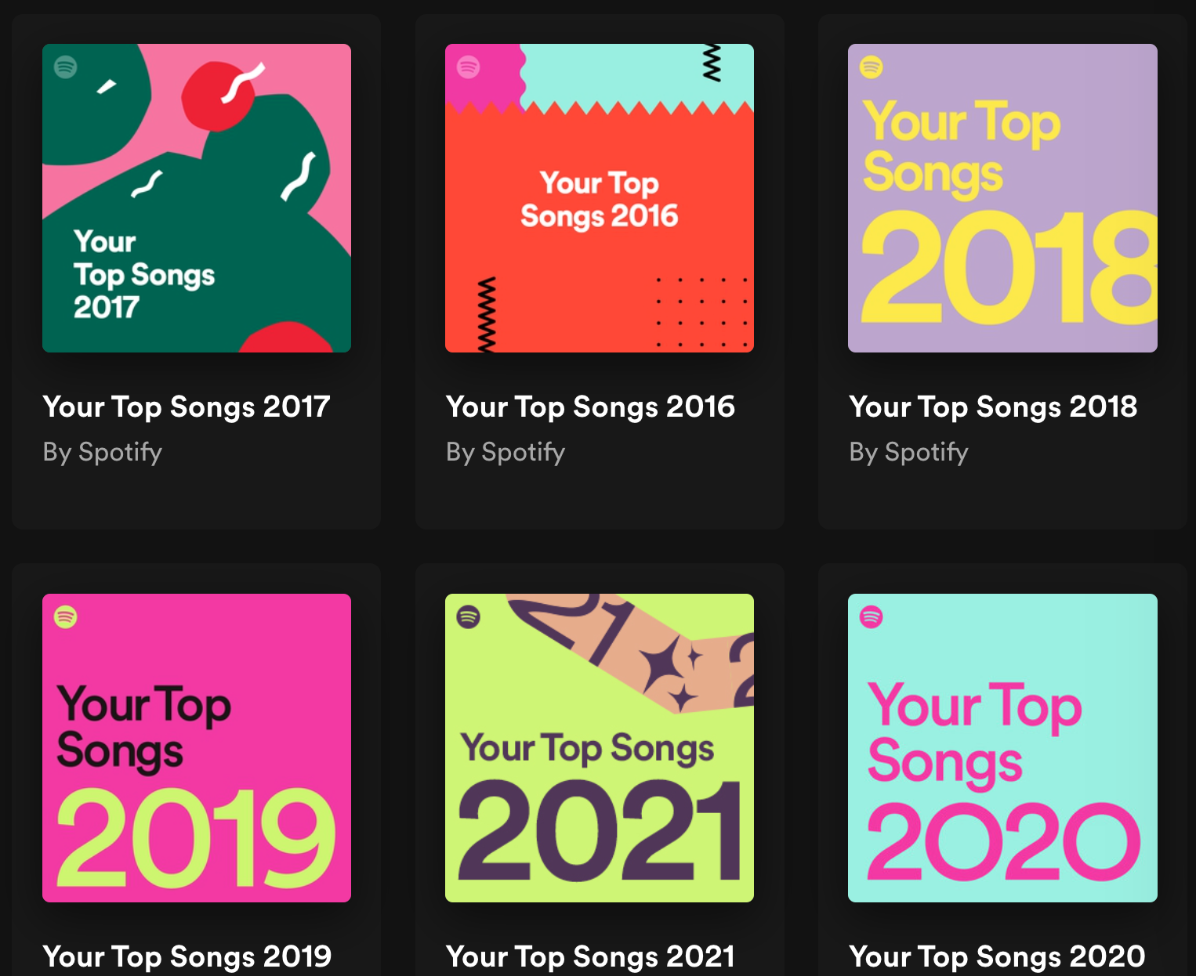
Agenda
Project overview
Visualizing my favorite songs
Modelling my music ‘taste profile’
Summary and next steps
Notes:
A quick overview of our presentation today…

Slide 3
Project Overview
Objective: Develop a machine learning model that learns a user’s music ‘taste profile’ based on their favorite Spotify tracks. This profile can be used to suggest new music that is similar to a user’s favorite tracks.
Data extraction: Using Spotify’s API, scraped the following data:
500 of my favorite songs, 2017 - 2020:
Used to investigate my musical taste
500 songs
50 of the Top Songs in the USA
This will be compared with my top tracks to see how my music taste compares to popular tracks of the day
50 songs
Notes:
This project is inspired by Spotify’s “Daily Mix” playlists which it develops for each user based on listening history of the user and other similar users
My goal is to develop a model that learns a user’s music taste profile based on their favorite tracks. The model could be used to evaluate whether new observations (new songs) fit within this music taste profile.
Pulled 500 of my favorite songs from 2017-2020, which would be used to build my music taste profile.
Pulled 50 of the Top Songs in the USA, which I could compare my songs to.

Slide 4
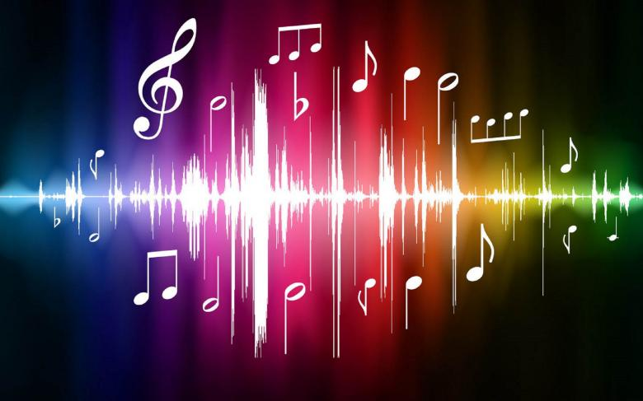
Overview of song attributes
In addition to basic track information, Spotify also provides several audio attributes:
Beats Per Minute (BPM) — The tempo of the song.
Energy — The higher the value, the more energetic.
Danceability — The higher the value, the more danceable the track
Loudness — The higher the value, the louder the song (in dB).
Valence — The higher the value, the more positive the mood.
Length — The duration of the song.
Acousticness — The higher the value the more acoustic the song
Instrumentalness — the higher the value, the fewer the vocals
Liveness — higher value indicate the presence of a live audience
Mode — indicates the modality (major or minor) of a track
Notes:
Here is a list of the song attributes that can be accessed for each Spotify song:
They describe musical attributes of the song (e.g. BPM, Loudness), the mood of the song (danceability, positivity).

Slide 5
Comparing my Favorite Tracks to the Top 50 Songs in the USA
Notes:
First, I will walk through how my music compared to the Top Songs in the USA.
Going in, I anticipate to see some differences between the two since my music taste tends to be more varied than what you would usually hear on the radio

Slide 6
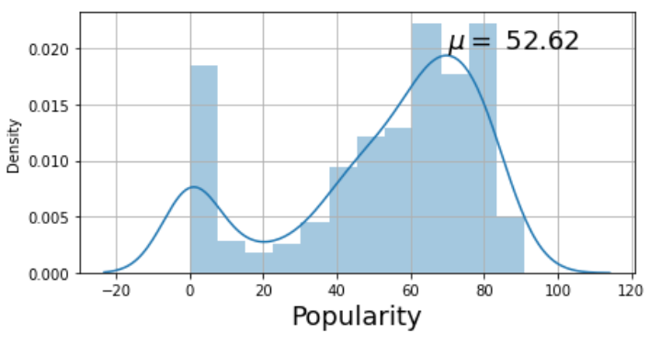
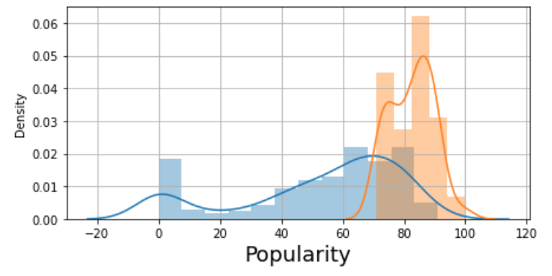
Top USA hits tend to be more popular than my favorite songs
My favorite songs
My favorite songs vs Top USA hits
μ = 82.50
More popular
Quite a few songs I listened to were relatively unknown
Notes:
Unsurprisingly, the songs on the Top USA hits charts were more ‘popular’ than my favorite songs.
On a scale of 0-100, where 100 is most popular, my favorite songs average 52/100 popularity. While the top songs scored 82.50 popularity

Slide 7
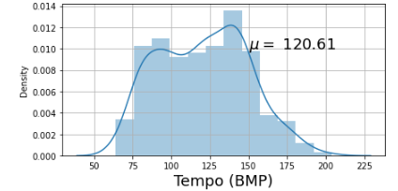
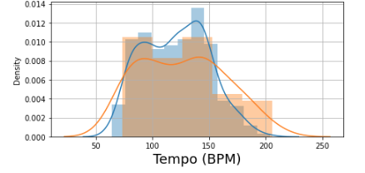
More of my favorite tracks had a higher tempo
My favorite songs
My favorite songs vs Top USA hits
μ = 126.56
My top tracks have a larger peak at higher BPMs, due to more techno songs
Techno BPM tends to be 120-160 range
Hip-Hop BPM tends to be 85-115
Notes:
On average, the Top USA Hits had a higher tempo than My favorite songs.
However, when we examine the density plot for my favorite tracks, we notice that there are two peaks, one around 90 BPM which coincides with Hip Hop songs. The second at the 140BPM, which tends to coincide with Techno songs.
My top tracks have a larger peak at higher BPMs, due to more electronic songs

Slide 8
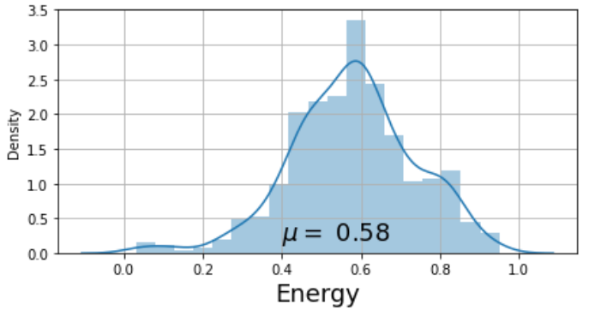
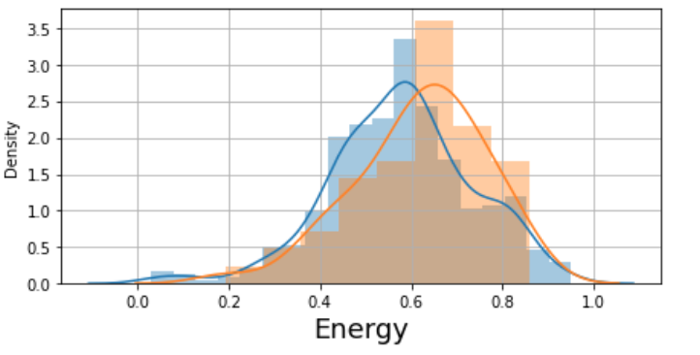
Energy levels for Top USA Tracks are slightly higher
My favorite songs
My favorite songs vs Top USA hits
μ = 0.62
More energetic

Slide 9
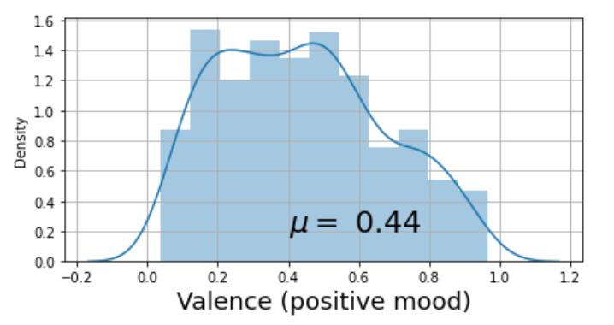
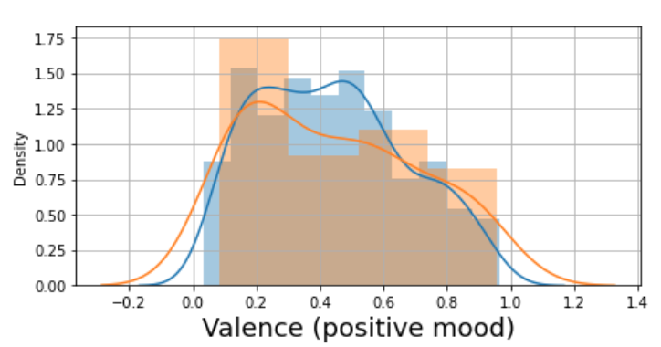
More of my favorite tracks tended to be more positive than the Top USA Hits
My favorite songs
My favorite songs vs Top USA hits
μ = 0.44
More positive mood
My top tracks have a larger peak at more positive moods.

Slide 10
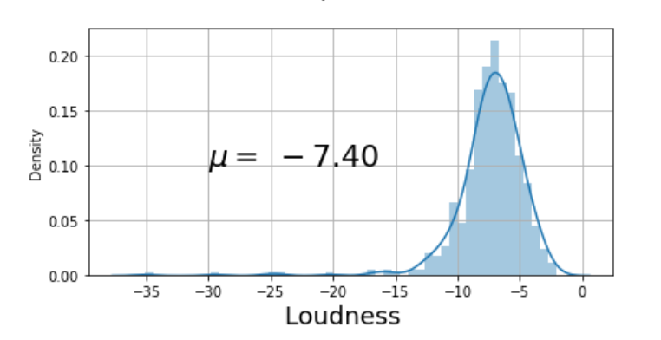
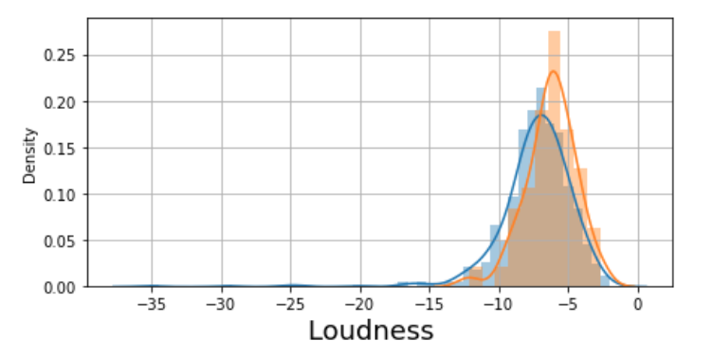
My favorite tracks tended to be louder than Top USA charts
My favorite songs
My favorite songs vs Top USA hits
μ = - 6.23

Slide 11
Modelling my Music Taste Profiles:
One-Class Support Vector Machines
Notes:
Next I will describe the modelling that I did to establish my music taste

Slide 12
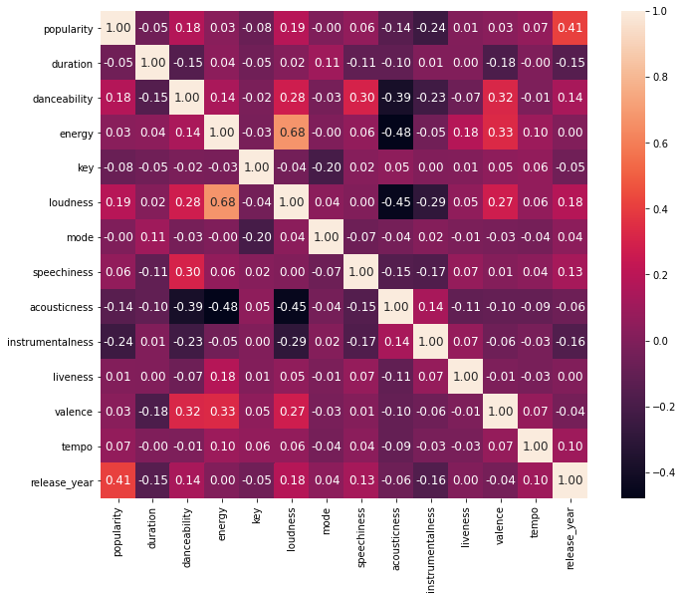
Very little correlation across features, with a few exceptions
Notes:
Before modelling, decided to check for correlation amongst Features. Correlation was low with a few exceptions:
[Energy vs Loudness]: 0.68
[Loudness vs Acousticness]: -0.45
[Energy vs Acousticness]: -0.46

Slide 13
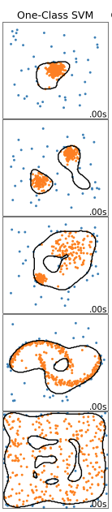
One-Class Support Vector Machine
Conceptually, I thought of building my ‘taste profile’ as a classification problem.
One challenge, unlike classification problems that have multiple classes — my ‘Favorite Songs’ dataset only included one-class i.e. songs that I like.
One-class SVM is an algorithm that can learn the the key characteristics of the class represented in the data, and predict whether a new observation is similar to the ‘in-class’ observations i.e. ‘songs I like’.
After fitting the OneClassSVM model on our scaled data, and tuning the parameters, we can visualize the ‘taste profile’ learned by the model.
Notes:
Conceptually, I decide to think of the problem of building my music taste profile as a classification problem.
However, our data had only one class – songs that In like.
The one-class SVM is an algorithm can create a learn the the key traits of some data, and compare it to new observations (in this case songs) and evaluate whether the new observations are similar to the data it has been trained on.
This model allows us to visualize the ‘taste profile’ that the model learns.

Slide 14
Reduce feature dimensionality with Principal Component Analysis
My ‘favorite tracks’ dataset contains 500 observations. For my model, I decided to focus on 10 features that described the musical attributes of the tracks:
['danceability', 'energy', 'loudness', 'mode', 'speechiness', 'acousticness', 'instrumentalness', 'liveness', 'valence', 'tempo']
PCA is an unsupervised machine learning technique that can reduce the number of dimensions - thus enabling us to project high dimensional data to a low-dimensional plane e.g. 2-D.
Before implementing PCA, standardized the features with scikit-learn’s StandardScaler
Notes:
I selected ten features that described the musical attributes of the tracks for my model, which are listed on the slide.
I wanted to be able to visualize my music taste profile in a 2-D space.
In order to project this high dimensional data to a 2-Dimensional plane, I used PCA to reduce the dimensions of the data, while preserving as much information as possible.

Slide 15
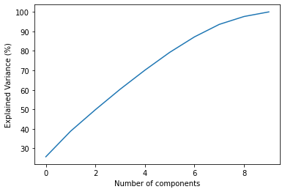
PCA Components and Explained Variance
Component | Top 3 Features in Component | % of Variance explained (cumulative)
0 (first) | ['loudness', 'energy', 'acousticness'] | 25.7%
1 (second) | ['speechiness', 'danceability', 'instrumentalness'] | 38.8%
2 (third) | ['mode', 'tempo', 'valence'] | 49.8%
9 (all features) | ['energy', 'loudness', 'danceability'] | 100%
Notes:
PCA reduced our features into components.
Each component represents a linear combination of the original features – I have printed the top 3 features in each component and the percent of the variance explained.

Slide 16
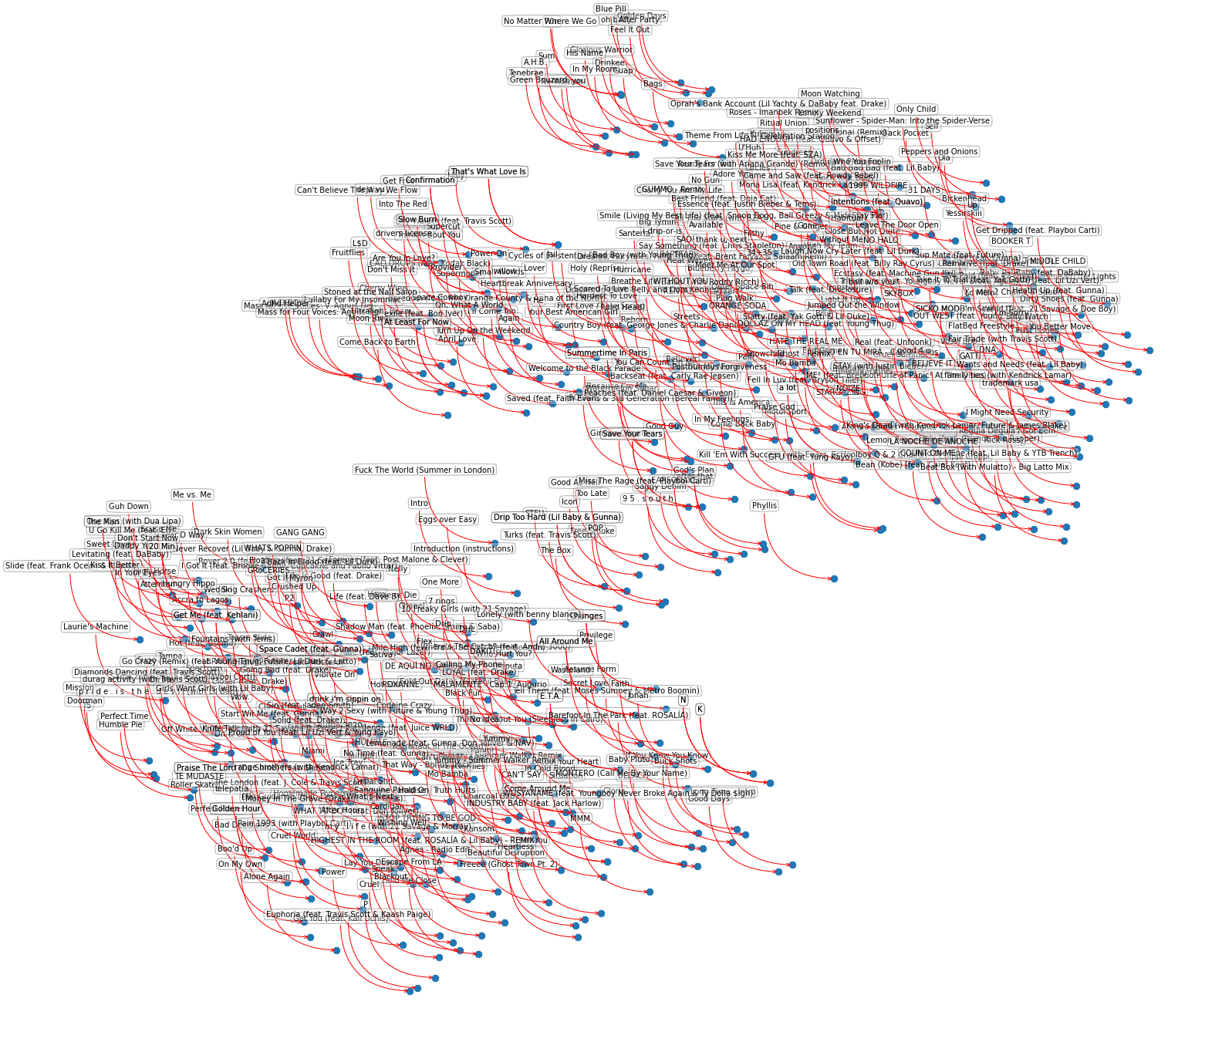
Visualizing all my favorite tracks in 2-D space
Notes:
Each song is represented on a 2-D space. Understandably, difficult to interpret – on the next slide, we focus on a specific artist

Slide 17
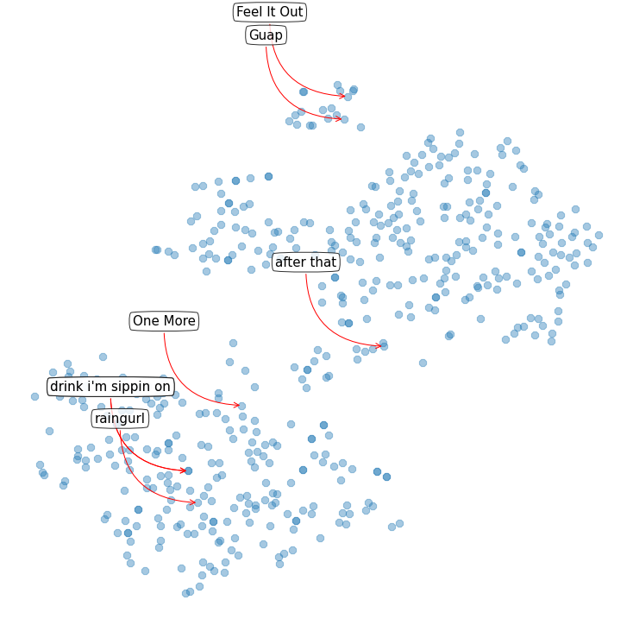
Spotlight on a specific artist ‘Yaeji’
These songs are more electronic/techno songs, fewer vocals
These songs are more ‘pop’, with vocals
Notes:
The same visual is much easier to digest when we labels songs for a specific artist. I decided to choose ‘Yaeji’ who is a DJ/Producer/Singer who has an eclectic discography.
Most of her songs are clustered in two areas

Slide 18
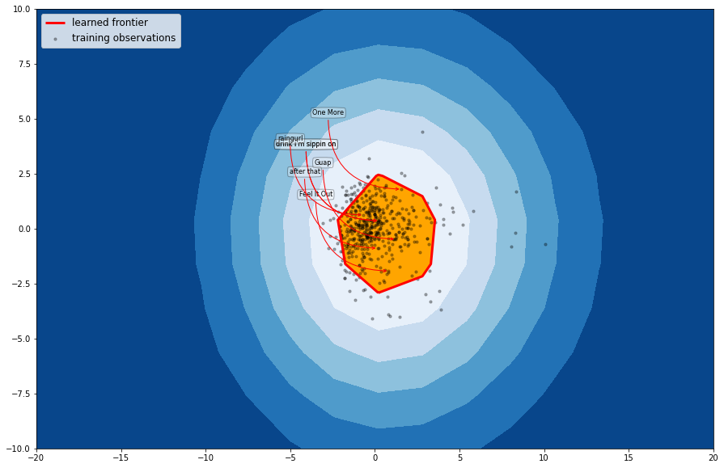
Personalized view of my music taste using OneClassSVM
Orange region represents my music taste
Notes:
By tuning the parameters we can find an optimal space in which we can make predictions.
If Spotify was to suggest new songs to me, it would check whether they would fall within the area shaded orange i.e. my music taste. Note that there are outliers which represent some of the more ‘unconventional songs’ in my library

Slide 19
Summary and Next Steps
Using Support Vector Machines, we were able to build my music ‘taste profile’ based on Spotify data.
This profile can be used to recommend new songs, based on their similarity to my favorite tracks
The taste profile was not perfect – it is difficult to deal with variation in songs.
Some next steps:
Consider adding more features e.g. sentiment of lyrics
Leverage other machine learning models to learn music taste e.g. Neural Nets
Build a web app that allows users to visualize their personal music taste

